Slide 1
DISPLAY LOCATION WHEN CALLING

Slide 2
Agenda
Inception
Identification of Problem
Solution of the Problem
Tools and Technologies Used
SDLC/ Model
Interface View
Code View
Future Work
Reference

Slide 3
Inception
The inception of idea is initiated to spy.
Taking information about the specific person.
Parents wants to know every act of their children, whom they are communicating.

Slide 4
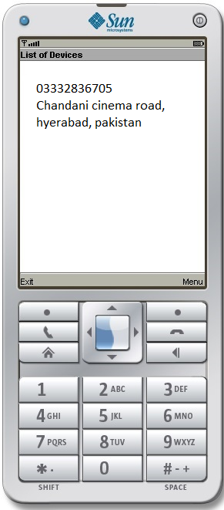
Location trackig

Slide 5
Introduction
As we have seen now a days smart phones are mostly used, and its application are used to makes the tasks easier. As we have seen our father and elder are always asking whom you talking to on phone, so this app provide the facilities to elder and individual that they can know whom you are talking to and sending message. This app has a parent child relation in which the display location coming on the child phone will create a log and alert to his parent about the phone calls and sms coming from the number.

Slide 6
Solution
Display location track through Gsm services, facilitates parent to their (Children) to keep track on (location), Sms packages now a days and most commonly in Pakistan.

Slide 7
tools and technologies used
Softwares (tools):
JAVA JDK
ADT plug-in
Eclipse
Photoshop (For Observer Logo)
The Android Emulator(Mobile Phone).
Hardwares:
Parent Can have (Smart phones or Symbian or normal phones) required tracking destination
Child Should have an Android phone.

Slide 8
SWOT Analysis
Strengths
Tracking 24 hrs
Number tracking
location Tracking
Call State tracking
Weakness
Dependent on mobile Network
Application installation
Opportunity
Can be Useful in theft
Can be useful for the prove
Threats
Same Application can be implemented
Application can be misuse
Application can be Deleted

Slide 9
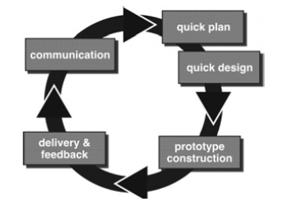
SDLC/Model
Evolutionary Model used
Prototyping
Quick plan made for the problem
Sms sending
Tracking number for Activity
Call State
Sms sending in proper context

Slide 10
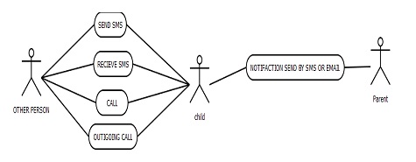
Entity Relationship Diagram

Slide 11
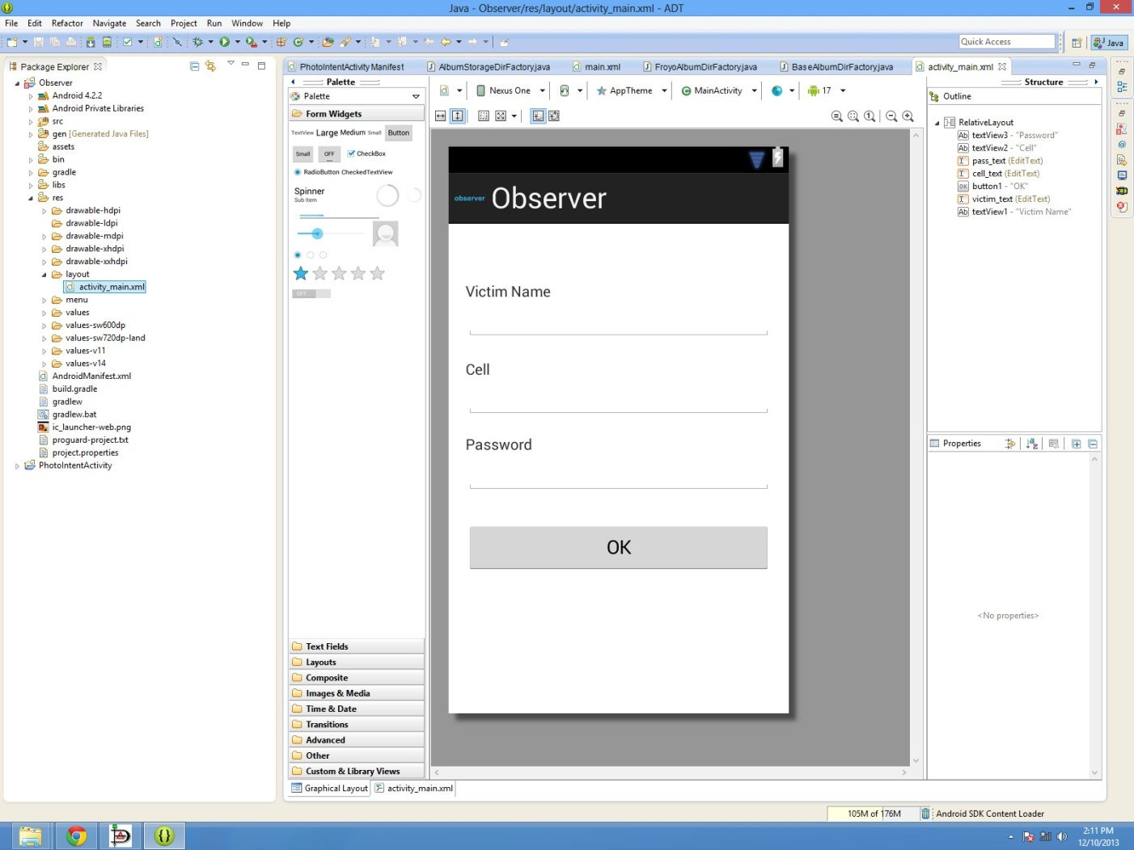
Interface (Snap Shots)

Slide 12
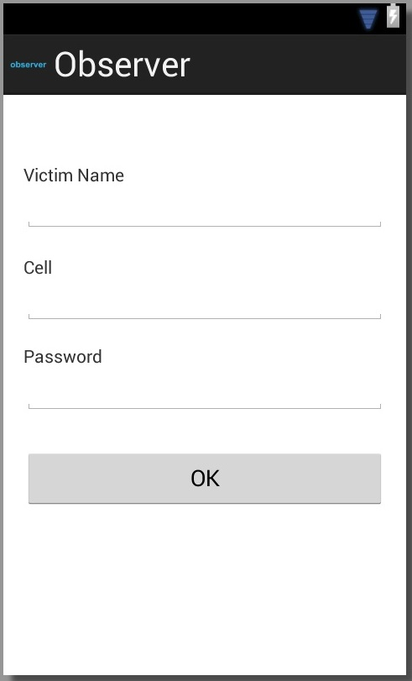
Contact
-id
-name
-phone_number
-status
-password

